Slide 1




What is Database???
A Database is a collection of related data organized in a way that data can be easily accessed, managed and updated.

Slide 2
A database can be of any size and complexity.
  Phone numbers stored in SIM memory
  Phone numbers stored on Memory card.
A database may be generated and maintained manually or it may be computerized.
  Library cards in your colleges (PUC)
  Library cards in GIT

Slide 3


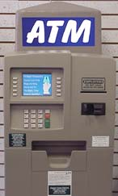
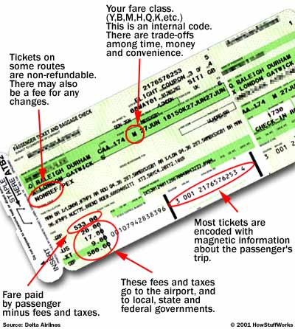

Other databases you may use

Slide 4




Implicit properties of Database

Slide 5
Implicit properties of Database
It represents some aspects of real world.
It is logically collection of data with some inherent meaning.
It is designed, built and populated with data for a specific purpose.

Slide 6





What is DBMS???
A DBMS is a general purpose software that facilitates the process of defining , constructing, manipulating and sharing of databases among various user and applications.
Dbms is actually a tool used to perform any kind of operation on data in database. Dbms also provides protection and security to database. It maintains data consistency in case of multiple users. Here are some examples of popular dbms, MySql, Oracle, Sybase, Microsoft Access and IBM DB2 etc.

Slide 7
Typical DBMS Functionality
Define a database : in terms of data types, structures and constraints
Construct or Load the Database on a secondary storage medium
Manipulating the database : querying, generating reports, insertions, deletions and modifications to its content
Concurrent Processing and Sharing by a set of users and programs – yet, keeping all data valid and consistent
Other features:
  Protection or Security measures to prevent unauthorized access
  “Active” processing to take internal actions on data
  Presentation and Visualization of data

Slide 8
Examples of Database Applications
Purchases using your credit card
Booking a holiday at the travel agents
Using the local library
Taking out insurance
Using the Internet
Studying at university
Many more …….

Slide 9
Components of Database System
USERS
Users : Users may be of various type such as DB administrator, System developer and End users.
Database application : Database application may be Personal, Departmental, Enterprise and Internal
DBMS : Software that allow users to define, create and manages database access, Ex: MySql, Oracle etc.
Database : Collection of logical data.
Database Application
DBMS
Database

Slide 10
Characteristics of the Database Approach
Self-describing nature of a database system: A DBMS catalog stores the description of the database. The description is called (meta-data). This allows the DBMS software to work with different databases.
Insulation between programs and data: Called program-data independence. Allows changing data storage structures and operations without having to change the DBMS access programs.
Data Abstraction: A data model is used to hide storage details and present the users with a conceptual view of the database.
Support of multiple views of the data: Each user may see a different view of the database, which describes only the data of interest to that user.

Slide 11
Sharing of data and multiuser transaction processing : allowing a set of concurrent users to retrieve and to update the database. Concurrency control within the DBMS guarantees that each transaction is correctly executed or completely aborted. OLTP (Online Transaction Processing) is a major part of database applications

Slide 12
Actors on the scene
  Database administrators: responsible for authorizing access to the database, for co-ordinating and monitoring its use, acquiring software, and hardware resources, controlling its use and monitoring efficiency of operations.
  Database Designers: responsible to define the content, the structure, the constraints, and functions or transactions against the database. They must communicate with the end-users and understand their needs.
  End-users: they use the data for queries, reports and some of them actually update the database content.
    a)Casual end users (Managers)
    b)Parametric end users( Accountant )
    c) Sophisticated end users (Engineers)
    d) Stand-alone end users (Users)

Slide 13



Actors on the scene
  Database administrators: responsible for authorizing access to the database, for co-ordinating and monitoring its use, acquiring software, and hardware resources, controlling its use and monitoring efficiency of operations.
  Database Designers: responsible to define the content, the structure, the constraints, and functions or transactions against the database. They must communicate with the end-users and understand their needs.
  End-users: they use the data for queries, reports and some of them actually update the database content.

Slide 14
Workers behind the scene
DBMS System designer and implementers: design and implement the DBMS modules and interfaces as a software package. It includes: catlogs, query processing, interfaces, accessing data, data recovery and security.
Tool developers: designs and implements tools. They include packages for database design, performance monitoring, simulations, test data generation.
Operators and maintenance personnel: are responsible for actually running and maintenance of the hardware and software environment of the database system.

Slide 15
Advantages of Using the Database Approach
Controlling redundancy in data storage and in development and maintenance efforts.
Sharing of data among multiple users.
Restricting unauthorized access to data.
Providing persistent storage for program Objects
Providing Storage Structures for efficient Query Processing
Providing backup and recovery services.
Providing multiple interfaces to different classes of users.
Representing complex relationships among data.
Enforcing integrity constraints on the database.
Drawing Inferences and Actions using rules

Slide 16
When not to use a DBMS
Main inhibitors (costs) of using a DBMS:
  High initial investment and possible need for additional hardware.
  Overhead for providing generality, security, concurrency control, recovery, and integrity functions.
When a DBMS may be unnecessary:
  If the database and applications are simple, well defined, and not expected to change.
  If access to data by multiple users is not required.
When no DBMS may suffice:
  If the database system is not able to handle the complexity of data because of modeling limitations

Slide 17
Three-Schema Architecture
End Users
External View
External View
External Level
Conceptual Mapping
Conceptual Schema
Conceptual Level
Internal Mapping
Internal Schema
Internal Level

Slide 18
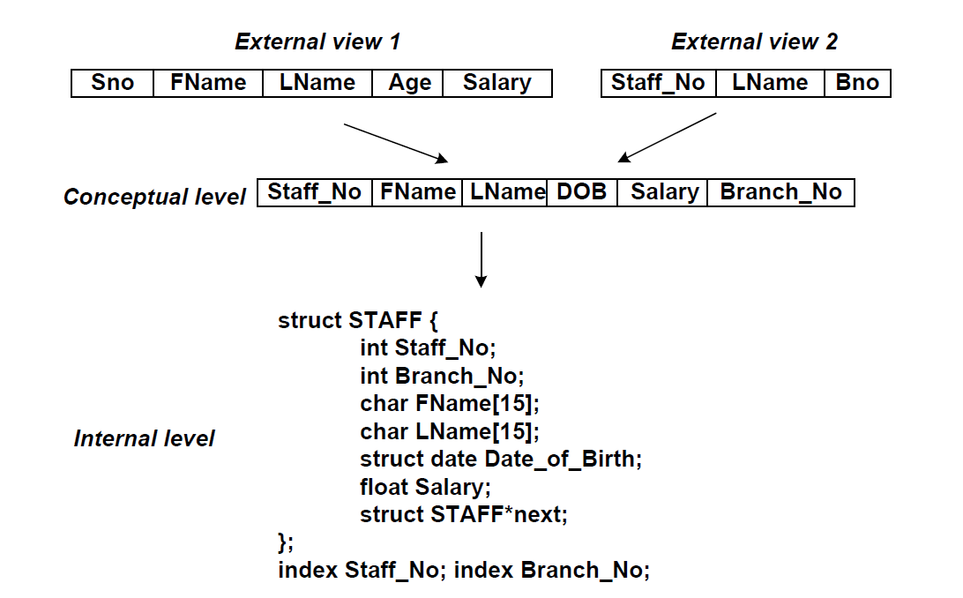
Example of 3 Schema Architecture
USER
MANAGER
How view is created
How data is stored

Slide 19
EXTERNAL LEVEL (highest level)
  The user’s view of the database.
  Consists of a number of different external views of the DB.
  Describes part of the DB for particular group of users.
  Provides a powerful and flexible security mechanism by hiding parts of the DB from certain users.
  It permits users to access data in a way that is customized to their needs, so that the same data can be seen by different users in different ways, at the same time.

Slide 20
CONCEPTUAL LEVEL
  The logical structure of the entire database as seen by DBA
  What data is stored in the database
  The relationships among the data
  Represents:
    entities, attributes, relations
    constraints on data
    semantic information on data
    security, integrity information

Slide 21
INTERNAL LEVEL
  Physical representation of the DB on the computer
  How the data is stored in the database
  Storage space allocation for data and indexes
  Data compression, encryption
  Record description for storage

Slide 22
Three-Schema Architecture
Defines DBMS schemas at three levels:
  Internal schema at the internal level to describe physical storage structures and access paths. Typically uses a physical data model.
  Conceptual schema at the conceptual level to describe the structure and constraints for the whole database for a community of users. Uses a conceptual or an implementation data model.
  External schemas at the external level to describe the various user views. Usually uses the same data model as the conceptual level.

Slide 23
Data Independence
Logical Data Independence: The capacity to change the conceptual schema without having to change the external schemas and their application programs.
Physical Data Independence: The capacity to change the internal schema without having to change the conceptual schema.

